Slide 1
What is a Database and Why use it?

Slide 2
Purpose of a Database
Keep track of things.
Unlike a spreadsheet, a database stores information that is more complicated.
College admin system: students transcripts, class schedules, departments and professors
Performance
Data is too large to read into memory
Efficient update, don’t rewrite the entire file
Multiple concurrent users, controlled sharing, recovery from failures

Slide 3
Relation
A relation is a two-dimensional table that has specific characteristics.
The table, like a spreadsheet, consists of rows and columns.

Slide 4
Terminology
Synonyms…
Table | Row | Column
File | Record | Field
Relation | Tuple | Attribute
Figure 2-6: Equivalent Sets of Terms

Slide 5
Characteristics of a Relation
Rows contains data about an entity.
Columns contain data on attributes of the entity.
Cells of the table hold a single value.
All entries in a column are of the same kind.
Each column has a unique name.
The order of the columns is unimportant.
The order of the rows is unimportant.
No two rows may be identical (or have same key)

Slide 6
A Nonrelation Example
Cells of the table hold multiple values
EmployeeNumber | Phone | LastName
100 | 335-6421, 454-9744 | Abernathy
101 | 215-7789 | Cadley
104 | 610-9850 | Copley
101 | 299-9090 | Jackson
Multiple rows with same key

Slide 7
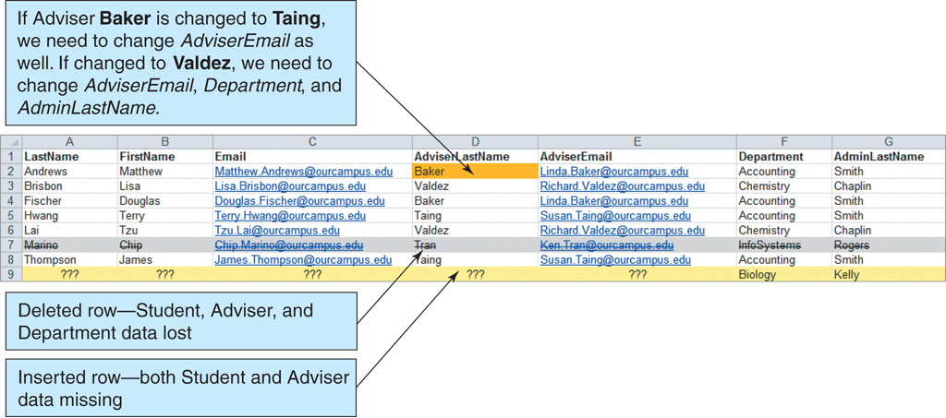
List Issues
Figure 1-5: The Student with Adviser and Department List

Slide 8
Normalization
Normalization—A process of analyzing a relation to ensure that it is well formed
More specifically, if a relation is normalized (well formed), rows can be inserted, deleted, or modified without creating update anomalies.
Duplicate data anomaly: advisor email stored multiple time
Dependency anomaly: to store advisor data, the advisor must have at least one student

Slide 9
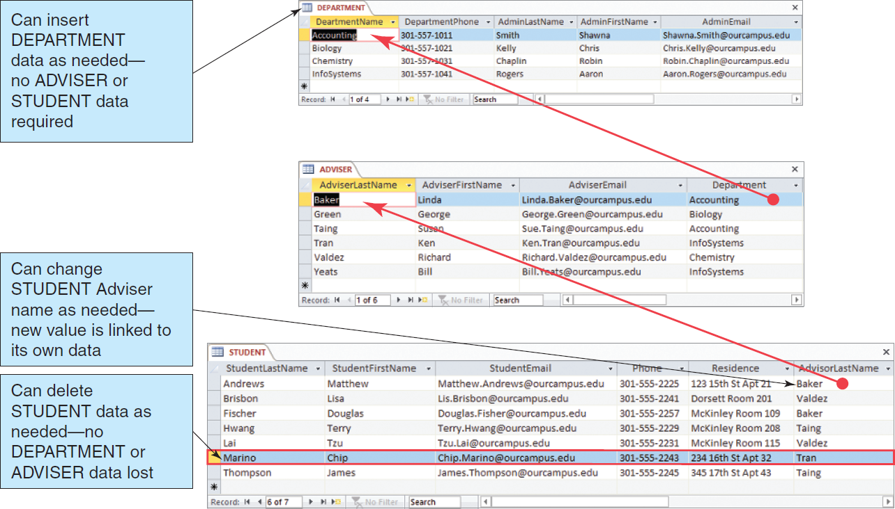
The Department, Advisor and Student Tables
Figure 1-8: The Department, Adviser, and Student Tables
Notes:
A department can be inserted into the department table without having advisor or student data. An advisor can be inserted into advisor table without any students. An advisor’s email and department is stored only once and not duplicated for each student.

Slide 10
Putting the Pieces Back Together
In our relational database, we broke our list into several tables. Somehow the tables must be joined back together.
In a relational database, tables are joined together using the value of the data.
Student-Advisor information is stored in tables for DEPARTMENT, ADVSIOR and STUDENT themes.

Slide 11
Relationships Between Tables
A table may be related to other tables.
the primary key of the related row is stored in the table. These columns are called a foreign key.
Student is related to Advisor
Advisor’s Last Name (primary key of Advisor table) is stored in Student table
Department is related to Advisor
Department (primary key of Department table) is stored in Advisor table

Slide 12
Sounds Like More Work, Not Less
A relational database is more complicated than a spreadsheet.
However, a relational database minimizes data redundancy, preserves complex relationships among topics, and allows for partial data.
Furthermore, a relational database provides a solid foundation for user forms and reports.

Slide 13
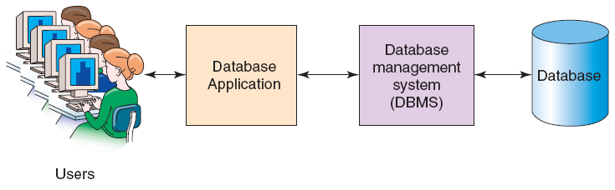
Components of a Web Application
Figure 1-15: Components of a Database System
Notes:
In the 80’s and 90’s, client server computing was about the application running on the user system and making remote connections to a shared database. In the 90’s and today, a web application is where the application runs on a web server and accesses the database, the user communicate to the application using tcpip, HTTP and HTML.

Slide 14
Database Management System (DBMS)
Just as an operating system acts as an intermediary between an application and the file system, a database management system (DBMS) serves as an intermediary between applications and the files used to store table data.
Simplifies the application code
Less errors, more consistency
Independence between application code and the database design. This allows the database schema to change (add new columns, add new tables, new indexes) without impacting existing programs.
The DBMS manages and controls database activities
optimizing search requests and efficient update
support multiple concurrent requests preventing interference between requests
backup and recovery from application, software, hardware failures.

Slide 15
AMP, LAMP and WAMP
AMP refers to a combination of the Apache Web server, the MySQL DBMS, and the PHP or Pearl programming language.
LAMP is AMP running on the Linux operating system.
WAMP is AMP running on the Windows operating system.
This class will use a AMP stack created by Bitnami.

Slide 16
Typical Web DBMS Servers
 | Microsoft Windows | Linux or Unix
Web Server | Internet Information Server (IIS) | Apache
DBMS | Microsoft SQL Server | Oracle Database Oracle MySQL
API Interface Standard | ODBC for Php or C++ | JDBC for Java
This class uses Apache, MySQL and mysqli php interface rather than ODBC. ODBC works mainly on windows. mysqli works on windows and linux.

Slide 17
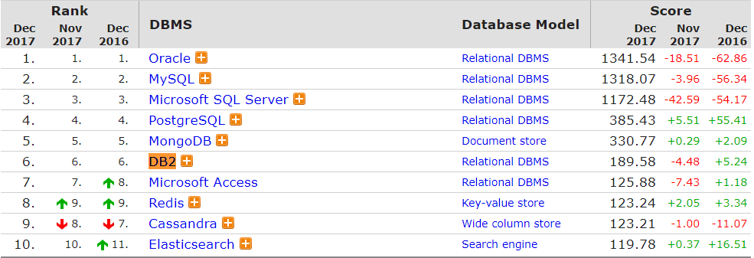
Top 10 Industry DBs
From http://db-engines.com/en/ranking which measures the frequency that these DBMSs are mentioned on the web.

Slide 18
Summary
A database stores large amounts of data and allows efficient query and modification and controlled sharing of data
Data is stored in one or more tables in rows (tuples) having unique keys in a normalized form
Normalization solves problems of update, insert and delete problems of complex data
SQL is the language used to retrieve and update data
A database system consists of the DBMS server and is often used in conjunction with a Web application server
JDBC, ODBC and are common programming interfaces for the Java language and the windows platform
mysqli is a programming interface unique to MySQL

